Slide 1
Our English library is getting richer thanks to our dear colleague, Fulbright English teaching assistant David Tallents. Thank you for the gift!
+ QUIZ !
Can you guess who is reading the new books? You can check answes at the end of the presentation.

Slide 2
David Tallents
The books in this collection represent some of my favorite novels. From The Great Gatsby, to Slaughterhouse-Five, to Dracula, these are the stories that made me fall in love with reading. It's my hope that these books will be loved by new readers as they have been loved by me all these years.​
I believe that these are some of the best novels and best writers the English language has to offer. I'm grateful to be able to share them with a new generation of readers.

Slide 3
1 Gertrude Chandler Warner The Boxcar children 1- 4
Henry, Jessie, Violet and Benny are brothers and sisters. They are orphans too, and the only way they can stay together is to make it on their own. When the children find an abandoned boxcar in the woods, they decide to call it home – and become the Boxcar Children!
No matter where they go, they find adventure. As they explore different places, they make amazing discoveries, investigate mysteries and realize there is more to the places and people than meets the eye...

Slide 4
2 Frank Herbert DUNE
Before The Matrix, before Star Wars, before Ender´s Game and Neuromancer, there was Dune, one of the greatest science fiction novels ever written.
Melange, or ´spice´, is the most valuable – and rarest – substance in the universe. And it can only be found on a single planet: the inhospitable desert world of Arrakis.
Whoever controls Arrakis controls the spice. And whoever controls the spice controls the universe.
When stewardship of Arrakis is transferred to his House, Paul Atreides must travel to the planet´s dangerous surface to ensure the future of his family and his people. But as malevolent forces explode into conflict around him, Paul is thrust into a great destiny beyond his understanding.
And his journey will change everything.

Slide 5
3 F. Scott Fitzgerald The Great Gatsby
There was music from my neighbor´s house through the summer nights. In his blue gardens men and girls went like moths among the whisperings and the champagne and the stars...
Enigmatic and fabulously wealthy, Jay Gatsby throws lavish parties at his West Egg mansion to impress Daisy Buchanan, the object of his obsession, now married to bullish Tom Buchanan. Over a Long Island summer, his neighbor Nick Carraway, a writer and a cousin to Daisy, looks on as Gatsby and Daisy´s affair deepens. Tragedy looms in F. Scott Fitzgerald´s masterpiece third novel, frequently named among the best novels of the twentieth century.

Slide 6
4 Ernest Hemingway For Whom the Bell Tolls
High in the pine forests of the Spanish Sierra, a guerrilla band prepares to blow up a vital bridge. Robert Jordan, a young American volunteer, has been sent to handle the dynamiting. There, in the mountains, he finds the dangers and the intense friendship of war. And there he discovers Maria, a young woman who escaped from Franco´s rebels.
For Whom the Bell Tolls is Hemingway´s finest novel, a passionate evocation of the pride and the tragedy of the Civil War that tore Spain apart.

Slide 7
5 Ernest Hemingway Fiesta: The Sun Also Rises
Paris in the twenties: Pernod, parties and expatriate Americans, loose-living on money from home. Jake is wildly in love with Brett Ashley, aristocratic and irresistibly beautiful, but with an abandoned, sensuous nature that she cannot change.
When the couple drifts to Spain to the dazzle of the fiesta and the intoxicating atmosphere of the bullfight, their affair is strained by new passions, new jealousies, and Jake must finally learn that he will never possess the woman he loves.
Powerful, intense, visually magnificent, Fiesta is the novel which established Ernest Hemingway as a writer of genius.

Slide 8
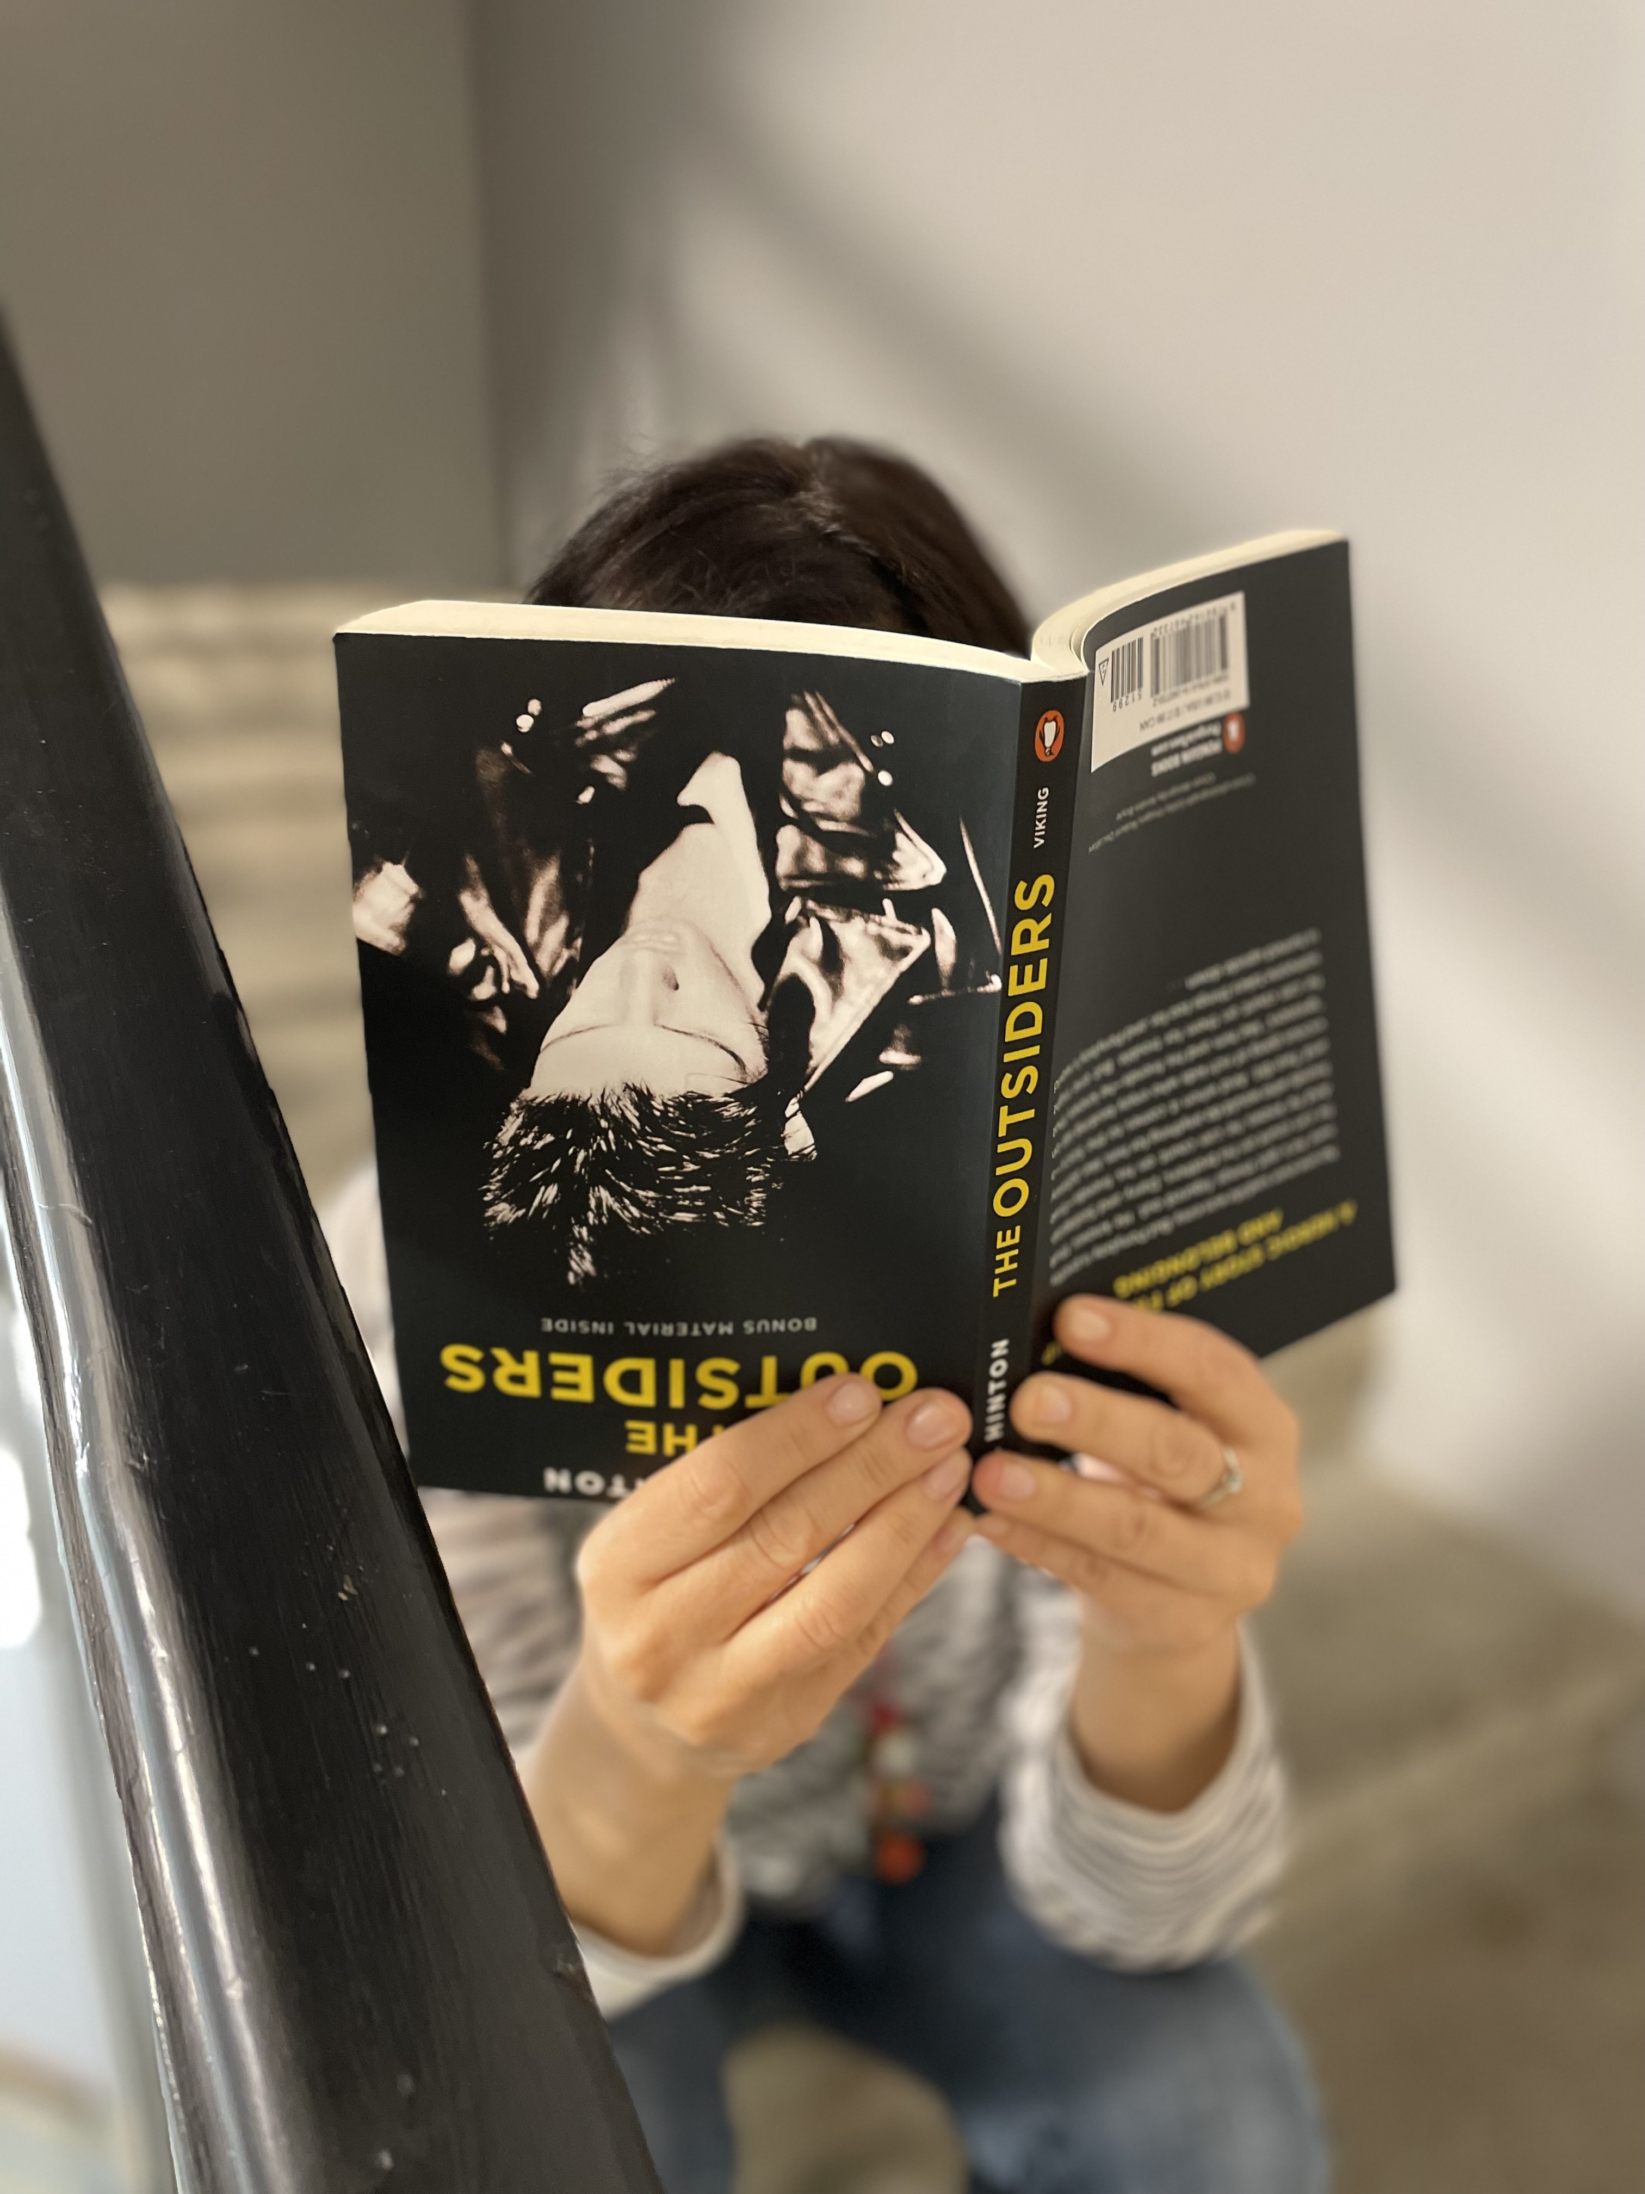
6 S.E. Hinton The Outsiders
No one ever said life was easy. But Ponyboy is pretty sure he´s got things figured out. He knows that he can count on his brothers, Darry and Sodapop. And he knows he can count on his friends – true friends who would do anything for him, like Johnny and Two-Bit. And when it comes to the Socs – a vicious gang of rich kids who enjoy beating up on ´´greasers´´ like him and his friends – he knows that he can count on them for trouble. But one night someone takes things too far, and Ponyboy´s world is turned upside down...
S. E. Hinton wrote this breakout novel at only 16 years old. At the time it was written, she failed her high school creative writing class.

Slide 9
7 C.S.Lewis The Chronicles of Narnia The Lion, the Witch and the Wardrobe
Four adventurers step through a wardrobe door and into the land of Narnia – a world enslaved by the power of the White Witch. When almost all hope is lost, the return of the Great Lion, Aslan, signals a great change....and a great sacrifice.
Book 2 of 7 in the classic series by C.S. Lewis

Slide 10
8 Sara Nović Girl at War
Growing up in Zagreb in the summer of 1991, ten-year-old Ana Jurić is a carefree tomboy: she runs the streets with her best friend, helps take care of her baby sister and idolizes her father. But when civil war breaks out, football games and school lessons are supplanted by sniper fire and air raid drills.
Ana is lost to a world of genocide and child soldiers in the brutality of the Bosnian-Croat conflict. A daring escape plan to America becomes her only chance for survival. Ten years later she returns to Croatia, a young woman struggling to belong to either country, forced to confront the trauma of her past and rediscover the place that was once her home.

Slide 11
9 George Orwell 1984
The year is 1984. War and revolution have left the world unrecognisable. Great Britain, now known as Airstrip One, is ruled by the Party, led by Big Brother. Mass surveillance is everything and the Thought Police ensure no individual thinking is allowed.
Winston Smith works at the Ministry of Truth, carefully rewriting history. But Winston dreams of freedom, and of rebellion. It is here that he falls in love with Julia, and starts a secret, forbidden affair with her - but in this world anything can be kept secret, and they are forced to face consequences more terrifying than either of them could have imagined.
A dystopian masterpiece, this is Orwell´s most famous and prophetic novel and a book that defined the twentieth century.

Slide 12
10 Erich Maria Remarque All Quiet on the Western Front
One by one the boys begin to fall...
In 1914 a room full of German schoolboys, fresh-faced and idealistic, are goaded by their schoolmaster to troop off to the ´glorious war´. With the fire and patriotism of youth they sign up. What follows is the moving story of a young ´unknown soldier´ experiencing the horror and disillusionment of life in the trenches.

Slide 13
11 Bram Stoker DRACULA
As she arched her neck she actually licked her lips like an animal, till I could see in the moonlight the moisture shining on the scarlet lips and on the red tongue as it lapped the white sharp teeth...
When Jonathan Harker arrives at castle Dracula in Transylvania, he has no idea of his host´s horrifying nocturnal habits. All too soon, he discovers that Dracula is a creature of pure evil that gorges on human blood. Barely escaping with his life, Jonathan flees for England and his new bride, Mina. But the Count isn´t finished with him yet...

Slide 14
12 John Steinbeck East of Eden
´Our species is the only creative species, and it has only one creative instrument, the individual mind and spirit of a man´.
California´s fertile Salinas Valley is home to two families whose destinies are fatally intertwined. Over the generations, between the beginning of the twentieth century and the end of the First World War, the Trasks and the Hamiltons will helplessly replay the fall of Adam and Eve and the murderous rivalry of Cain and Abel.
East of Eden explores universal themes of love and identity and remains one of America´s most enduring novels.

Slide 15
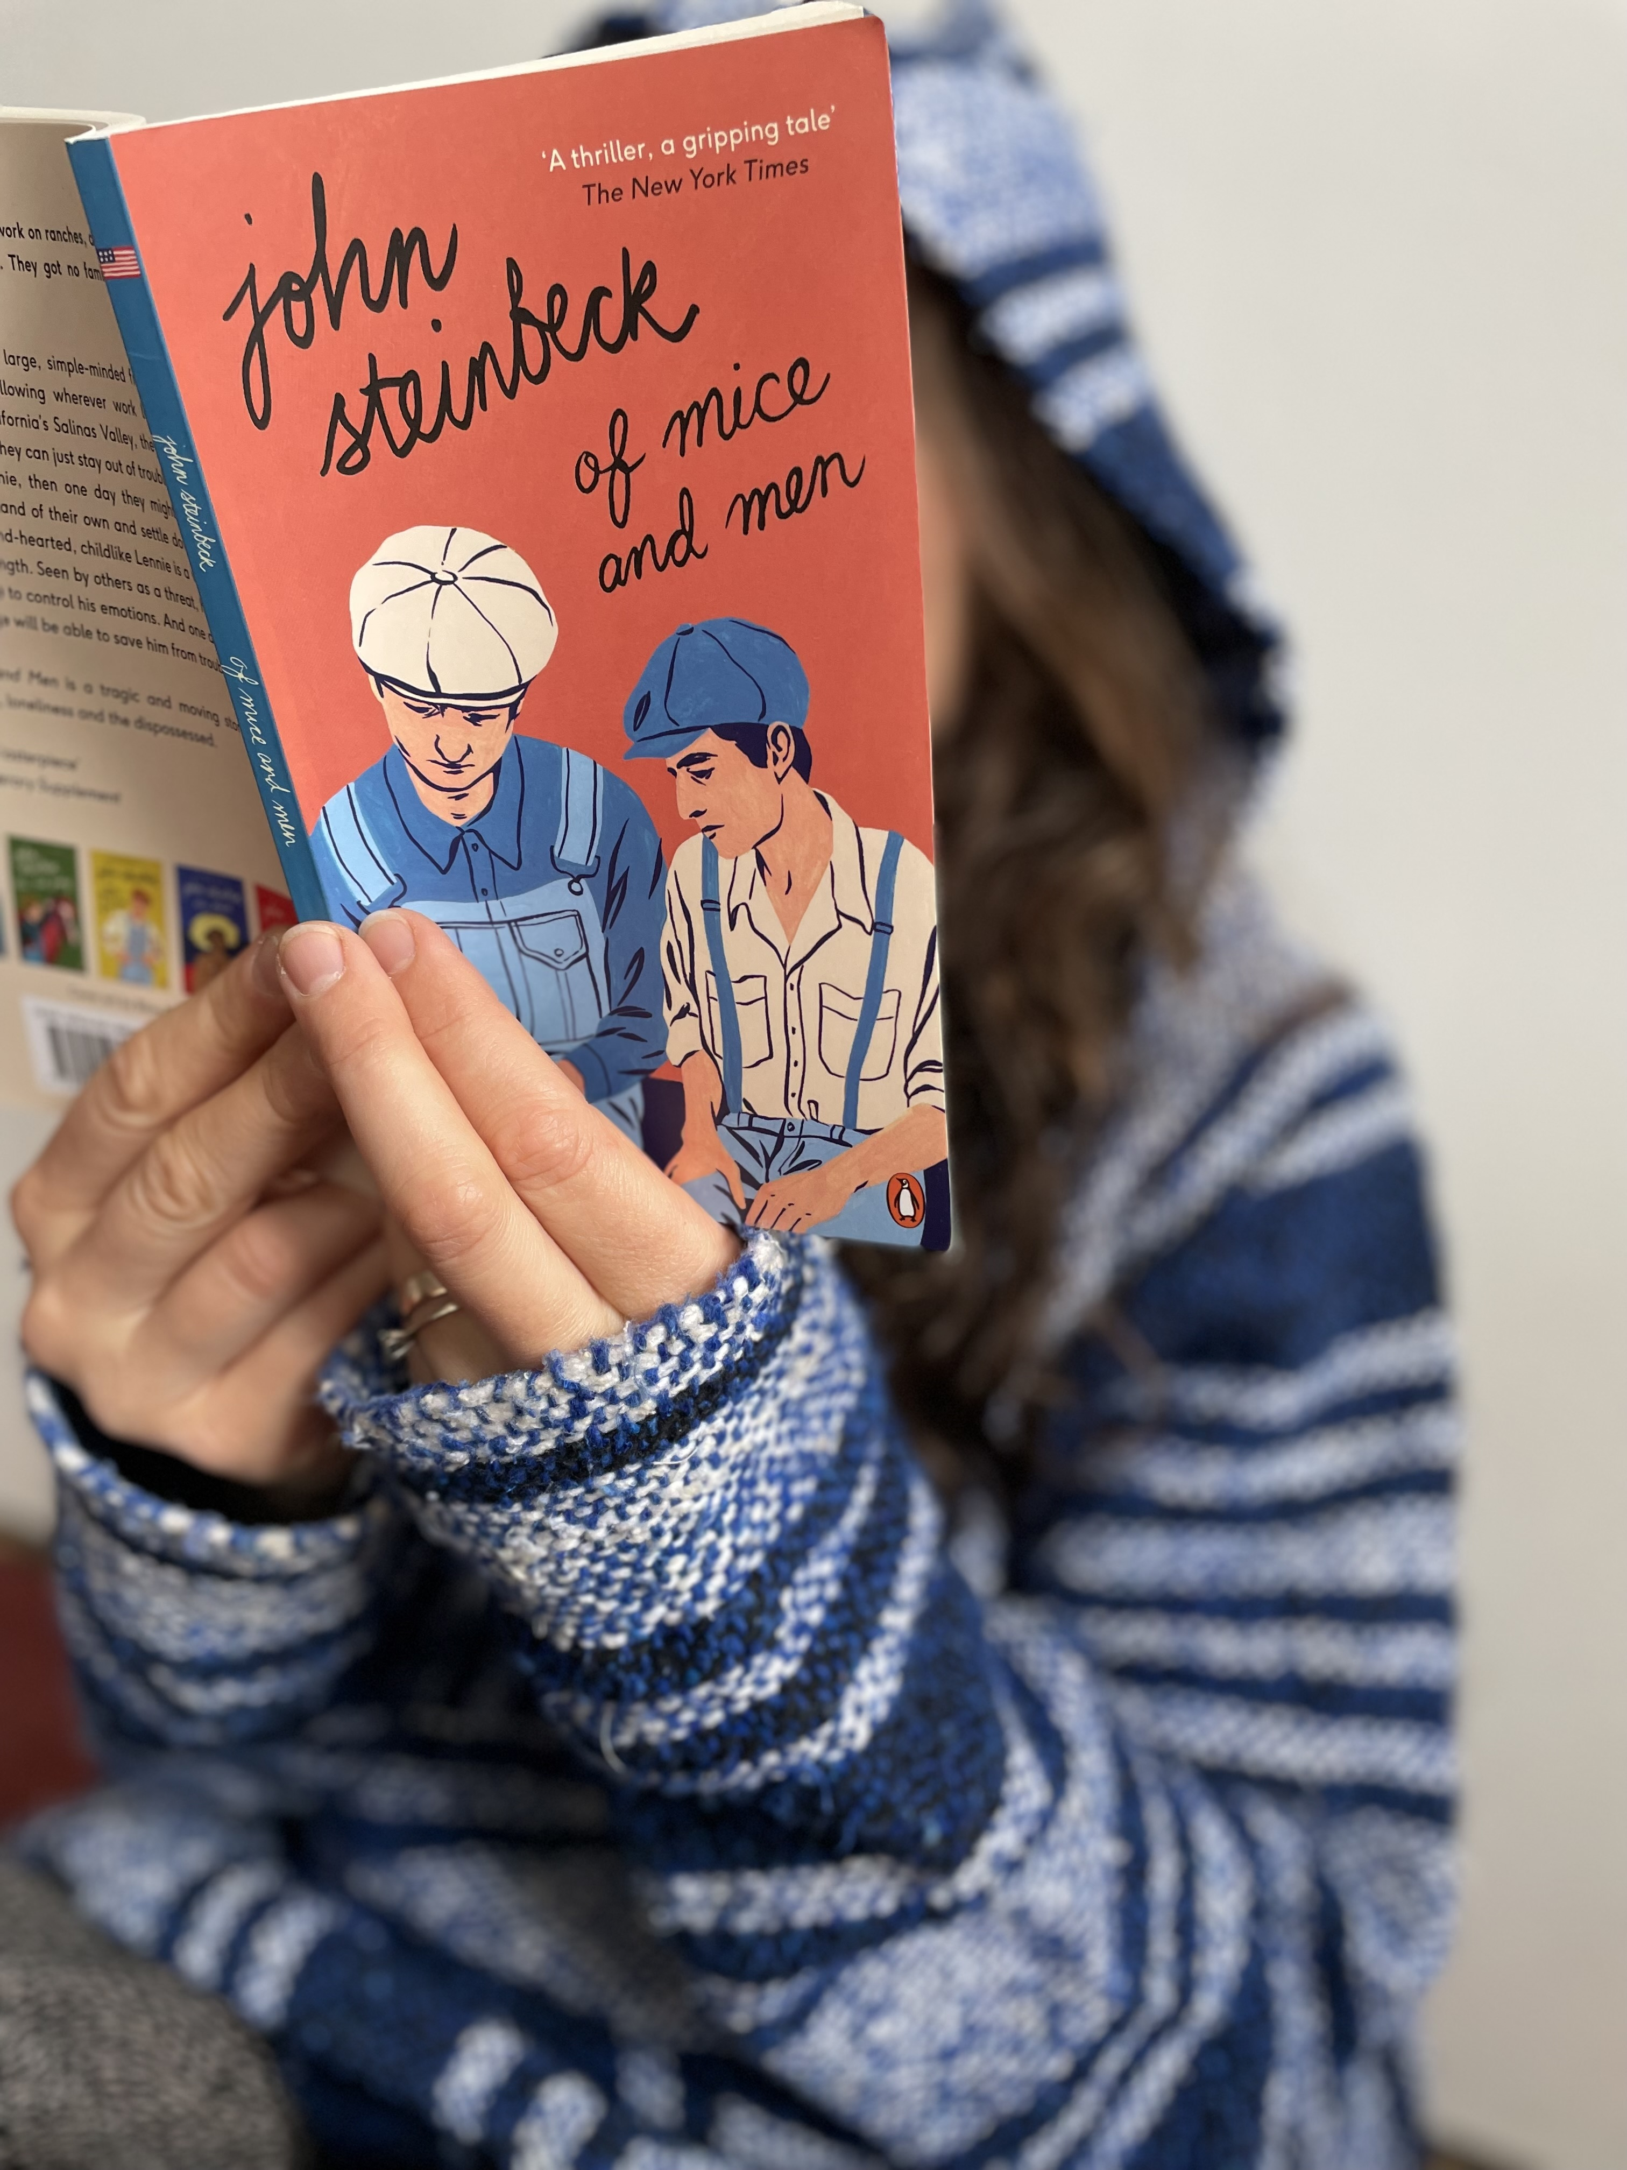
13 John Steinbeck Of Mice and Men
"Guys like us, that work on ranches, are the loneliest guys in the world. They got no family. They don´t belong to no place."
George and his large, simple-minded friend Lennie are drifters, following wherever work leads them. Arriving in California´s Salinas Valley, they get work on a ranch. If they can just stay out of trouble, George promises Lennie, that one day they might be able to get some land of their own and settle down some place. But kind-hearted, childlike Lennie is a victim of his own strength. Seen by others as a threat, he finds it impossible to control his emotions. And one day not even George will be able to save him from trouble.
Of Mice and Man is a tragic and moving story of friendship, loneliness and the dispossessed.

Slide 16
14 John Steinbeck The Grapes of Wrath
Shocking and controversial when it was first published.
The Pulitzer Prize winning epic of the Great Depression, a book with an overwhelming and sometimes outraging effect on millions of readers.
Tells the story of an Oklahoma family, the Joads, hardworking farmers who lost everything in the Oklahoma Dust Bowl in the 1930s ( 3 million tons of topsoil were carried away by a wall of blowing sand and dust). Driven from their home and forced to travel west to the promised land of California they struggle to find work.
A portrait of the conflict between the powerful and the powerless, of one man´s fierce reaction to injustice and of one woman´s calm strength, the novel captures the horrors of the Great Depression and probes into the very nature of equality and justice in America.

Slide 17
15 Kurt Vonnegut Breakfast of Champions
Tells the story of the events that led up to the meeting of Kilgore Trout and Dwayne Hoover. Trout is a struggling science fiction author who, after meeting Hoover – his fellow fictional character - becomes successful and wins a Nobel Prize. Dwayne Hoover is a fabulously well-to-do car salesman on the brink of insanity. The meeting is brief, but it´s a moment of transformation...
It´s largely a novel about writing a novel, a miraculous mix of science fiction, memoir, parable, fairy tale and farce.
The book includes Vonnegut´s drawings which explain everything from an apple to the pyramids and expresses his original opinions on the whole spectrum of American society.
Thought-provoking, unputdownable, weird, fast and inventive...

Slide 18
16 Kurt Vonnegut Slaughterhouse - Five
Kurt Vonnegut was born in Indianapolis in 1922 and studied biochemistry at Cornell University. During the Second World War he served in Europe and, as a prisoner of war in Germany, witnessed the destruction of Dresden by Allied bombers, an experience which inspired his classic novel Slaughterhouse-Five
It´s one of the world´s great antiwar books. Billy Pilgrim has mysteriously become unstuck in time. He goes on an uncontrollable trip back and forth from his birth in New York to life on a distant planet and back again to the horrors of the 1945 fire-bombing of Dresden.
A funny book at which you are not permitted to laugh, a sad book without tears.

Slide 19
KEY to the quiz:
1 Lenka Vetýšková
2 Vítek Zeman
3 Daniela Šímová
4 Ivana Pečtová
5 Martina Kohoutová
6 Alena Kubátová Hendrychová
7 Peter Dunn
8 Robert Vyhlídka
9 Jana Kittová
10 Pavel Jarčevský
11 David Tallents
12 Radek Přerovský
13 Květa Pilná
14 Ondřej Kazda
15 Hana Jiráková
16 Jakub Kára

